Slide 1
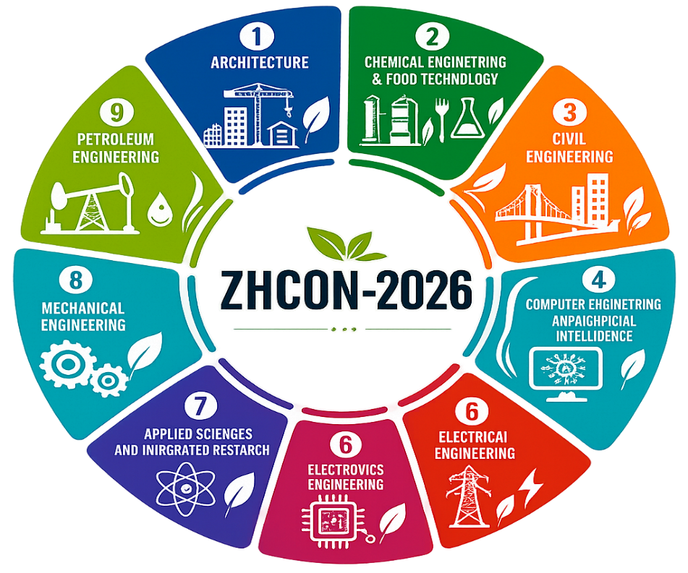

ZHCON-2026
International Conference
Sustainable in Design, Engineering & Architecture
Zakir Husain College of Engineering & Technology
Aligarh Muslim University
TITLE
Your name, co-author 1 name, co-author 2 name
*Affiliation 1, contact details
**Affiliation 2, contact details
*** Affiliation 3, contact details
ABSTRACT
The poster presentation template is meant as a guide for what a poster presentation should look like for the International Conference on Sustainable Design, Engineering, Architecture and Applied Sciences (ZHCON-2026). The abstract should provide a concise overview of the research, highlighting the background, objectives, methodology, key findings, and major conclusions. It should clearly highlight the novelty, significance of the study and stimulate discussion at the conference. A structured abstract makes it easy for readers to understand the purpose, method and results of the research, and helps to introduce the reader to the poster presentation. In this version, the text in the placeholders is tailored to the purpose of writing a conference poster template, and not used in a generic way.
Keywords:
INTRODUCTION
The introduction should set the context for the research by stating the research problem, its importance and the existing knowledge base in the field. It needs to be clear why the research was undertaken, what the gap is that is being filled and clearly state the objectives or research questions. Be brief and informative, giving the readers enough background so they can see how important the work is.
Summarize the research findings in figures, graphs, photographs, charts or tables, whenever possible. Highlight the key points and avoid overloading with data. All figures and tables need to have a descriptive title. Results presented in a visually organized format enable readers to easily interpret results and appreciate the importance of the research.
Interpret the results by explaining their meaning and connecting them to the research questions. Summarize the results, if applicable, by comparing them with results from earlier studies; emphasize new aspects or applications of the study. Give a few brief references to any limitations if there are any, and indicate some possible directions for further research if they are available. This section should show the contribution of the study to science.
RESULTS & DISCUSSIONS
METHODOLOGY
The methodology should outline research without any technical jargon so that readers can follow the research without needing to read the entire article. Explain experimental design, materials, method, analysis, or computation in a logical and concise way. Use flowcharts, diagrams, photographs, or schematic drawings to improve clarity and to communicate the research process, where possible. Make sure to cover the following points:
Describe the research approach or process.
Describe briefly materials, equipment, or software used.
Describe experimental or analytical procedures.
Use flowcharts, diagrams or figures to illustrate the method.
Make sure content is brief, cohesive, and clear.
In a few short statements summarize the key results of the research. Emphasize how the goals of the research were met and the overall significance of the research. End with the general implication, meaning or suggestions of the research. Be succinct, to the point, and include the main “take home” message.
CONCLUSIONS
Reference Style: APA Style
Book: Author, A. A. (Year). Title of book. Publisher.
Journal Article: Author, A. A. & B. B. (Year). Title of article. Journal Name, Volume (Issue), Page numbers. doi/url.
Website: Author, A. A. (Year, Month Day). Title of page. Website Name. URL.
REFERENCES
ACKNOWLEDGEMENT: This section can recognize the financial support, institutional assistance, collaborators, funding agencies, laboratories, supervisors, or any other people who contributed to the successful completion of the research.
SPONSORS

